Slide 1
Graph Algorithms
Jiexin Wang
School of Software Engineering
South China University of Technology

Slide 2
Graph Searching
Section 9.5 and 9.6

Slide 3
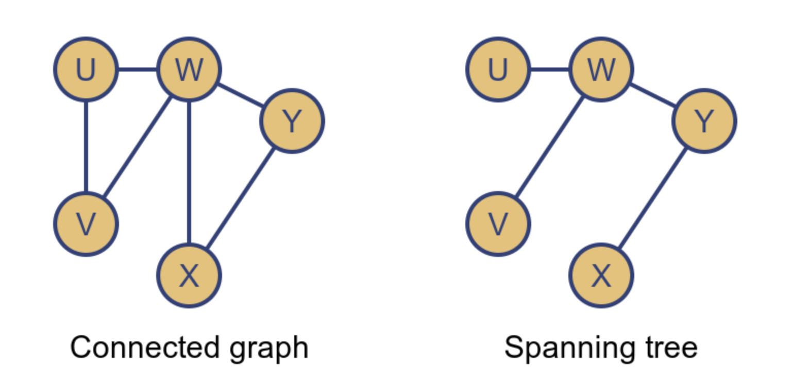
Graph Searching
  Connected Graph：A graph is called a connected graph if, for every pair of vertices 𝑢 and 𝑣 in the graph, there is a path between 𝑢 and 𝑣 。
  Spanning trees：In a connected graph, a spanning tree is a subgraph that includes all the vertices and contains no cycles. The number of edges in a spanning tree is always n−1 where n is the number of vertices。
  Bipartite structure：A graph is bipartite if its vertex set can be divided into two disjoint sets, such that every edge connects a vertex from one set to a vertex in the other set. There are no edges connecting vertices within the same set。

Slide 4
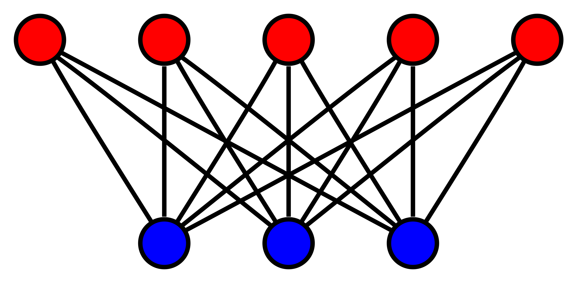
Graph Searching
  Connected Graph：A graph is called a connected graph if, for every pair of vertices 𝑢 and 𝑣 in the graph, there is a path between 𝑢 and 𝑣 。
  Spanning trees：In a connected graph, a spanning tree is a subgraph that includes all the vertices and contains no cycles. The number of edges in a spanning tree is always n−1 where n is the number of vertices。
  Bipartite structure：A graph is bipartite if its vertex set can be divided into two disjoint sets, such that every edge connects a vertex from one set to a vertex in the other set. There are no edges connecting vertices within the same set。

Slide 5
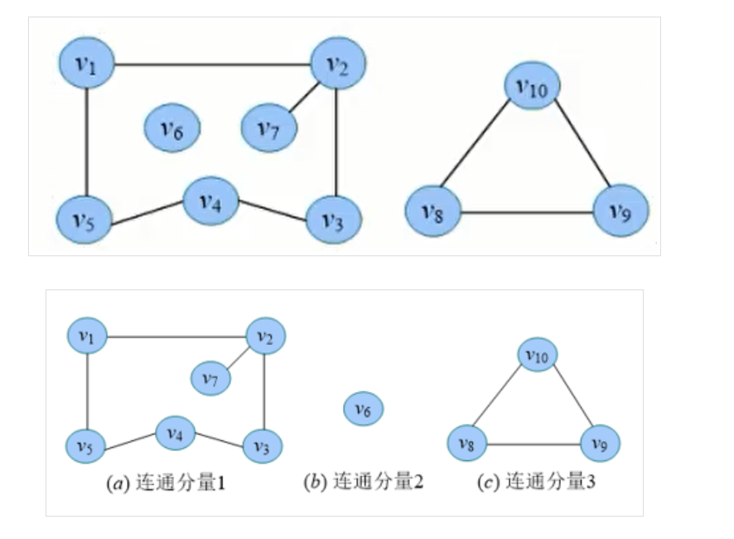
Graph Searching
  Connected components：In an undirected graph, a connected component is a subset of the graph where any two vertices are connected by a path.
  Biconnected components：In an undirected graph, a biconnected component is a maximal subgraph such that removing any single vertex does not disconnect the graph. If removing a vertex disconnects the graph, that vertex is called a cut vertex or articulation point。

Slide 6
Graph Traversals
Recall traversal of binary trees
  Preorder, inorder, or postorder traversal

Slide 7
Traversing Binary Trees
Preorder: Node, then Children (starting with the left) recursively
  + * + A B C D
Inorder: Left child recursively, Node, Right child recursively
  A + B * C + D
Postorder: Children recursively, then Node
  A B + C * D +
+
*
D
+
C
A
B

Slide 8
Graph Traversals
Recall traversal of binary trees
  Preorder, inorder, or postorder traversal
Graph traversal: visit the vertices of a graph in some specific order based on the graph’s topology.
Traversal algorithms typically begins with a start vertex and attempt to visit the remaining vertices from there
  The traversal can only follow the edges in the graph.
  It may not be possible to reach all vertices if the graph is not connected
  The algorithms shall make sure not to go into an infinite loop if the graph contains cycles.

Slide 9
Graph Traversals
A mark bit is maintained for each vertex
  If a marked vertex is encountered during traversal, it is not visited a second time
  If not all vertices are marked when the algorithm completes, we continue the traversal from another unvisited vertex.
void graphTraverse(Graph* G) {
int v;
for (v=0; v<G->n(); v++)
G->setMark(v, UNVISITED); // Initialize
for (v=0; v<G->n(); v++)
if (G->getMark(v) == UNVISITED)
doTraverse(G, v);
}

Slide 10
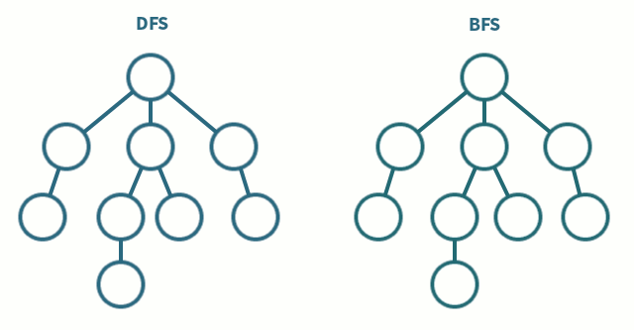
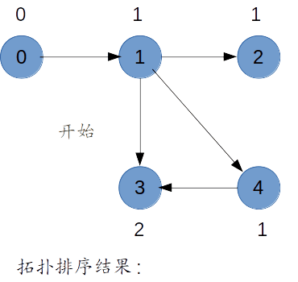
Graph Traversals
Three typical graph traversal strategies
  Depth-first search (DFS)
  Breadth-first search (BFS)
  Topological sort

Slide 11
Graph Searching Methodology
Breadth-First Search (BFS)
  Use a queue to explore neighbors of source vertex, then neighbors of neighbors etc.
  All vertices at a given distance (in number of edges) are explored before we go further
Depth-First Search (DFS)
  Searches down one path as deep as possible
  When no vertices available, it backtracks
  When backtracking, it explores side-paths that were not taken
  Uses a stack (instead of a queue in BFS)
  Allows an easy recursive implementation

Slide 12
Depth First Search Algorithm
Recursive marking algorithm
Initially every vertex is unmarked
DFS(i: vertex)
mark i;
for each j adjacent to i do
if j is unmarked then DFS(j)
end{DFS}
DFS(i)
i
DFS(j)
j
Marks all vertices reachable from i
k

Slide 13
Depth First Search Algorithm
void DFS(Graph* G, int v) {
PreVisit(G, v); // Take some actions
G->setMark(v, VISITED); //mark v
for (int w=G->first(v); w<G->n(); w=G->next(v,w))
if (G->getMark(w) == UNVISITED)
DFS(G, w);
PostVisit(G, v); // Take some actions
}

Slide 14
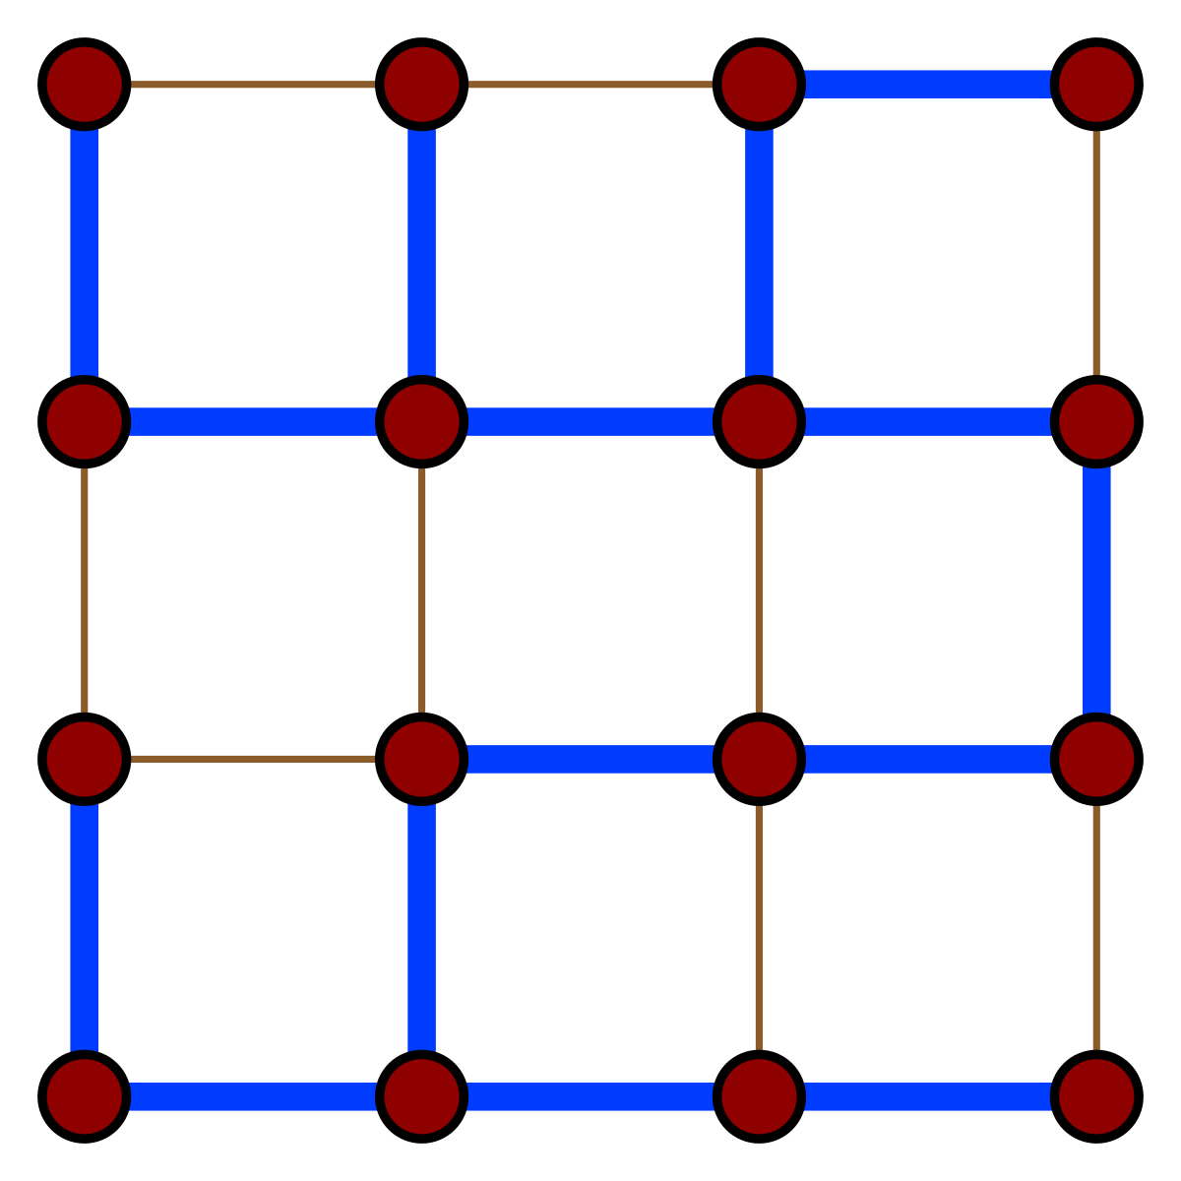
DFS Application: Spanning Tree
Given a graph G(V,E), a spanning tree of G is a graph G’(V’,E’)
  V’ = V, the tree touches all vertices (spans) the graph
  E’ is a subset of E such G’ is connected and there is no cycle in G’
  A graph is connected if given any two vertices u and v, there is a path from u to v

Slide 15
DFS Application: Spanning Tree
Example of DFS: Graph connectivity and spanning tree
2
1
DFS(1)
7
3
5
6
4

Slide 16
DFS Application: Spanning Tree
2
1
DFS(1)
DFS(2)
7
3
5
6
4
Red links will define the spanning tree if the graph is connected

Slide 17
DFS Application: Spanning Tree
2
DFS(1)
DFS(2)
DFS(3)
DFS(4)
DFS(5)
1
7
3
5
6
4

Slide 18
DFS Application: Spanning Tree
2
DFS(1)
DFS(2)
DFS(3)
DFS(4)
DFS(5)
DFS(3)
DFS(7)
1
7
3
5
6
4

Slide 19
DFS Application: Spanning Tree
2
DFS(1)
DFS(2)
DFS(3)
DFS(4)
DFS(5)
DFS(7)
1
7
3
5
6
Now back up.
4

Slide 20
DFS Application: Spanning Tree
2
DFS(1)
DFS(2)
DFS(3)
DFS(4)
DFS(5)
1
7
3
5
6
Back to 5,
but it has no
more neighbors.
4

Slide 21
DFS Application: Spanning Tree
2
DFS(1)
DFS(2)
DFS(3)
DFS(4)
DFS(6)
1
7
3
5
6
Back up to 4.
From 4 we can
get to 6.
4

Slide 22
DFS Application: Spanning Tree
2
DFS(1)
DFS(2)
DFS(3)
DFS(4)
DFS(6)
1
7
3
5
6
From 6 there is
nowhere new
to go. Back up.
4

Slide 23
DFS Application: Spanning Tree
2
1
DFS(1)
DFS(2)
DFS(3)
DFS(4)
7
3
5
Back to 4.
Keep backing up.
6
4

Slide 24
DFS Application: Spanning Tree
2
DFS(1)
1
7
3
All the way
back to 1.
Done.
5
6
4
All nodes are marked so graph is connected; red links define a spanning tree

Slide 25
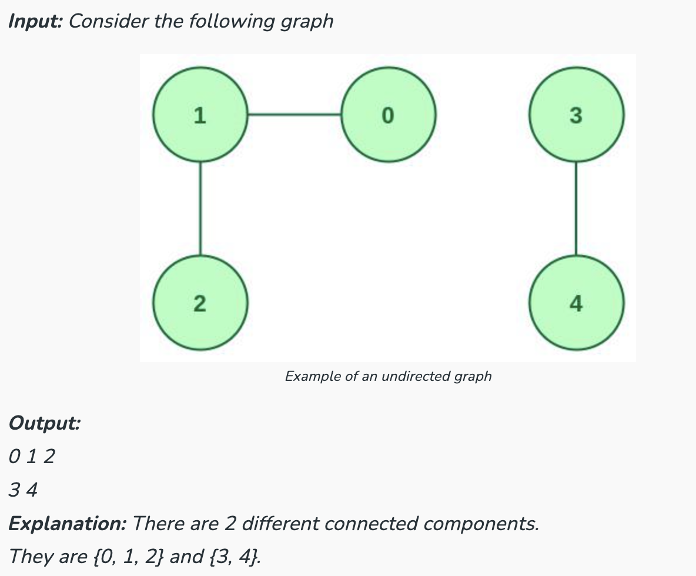
Another Use for Depth First Search: Connected Components

Slide 26
Connected Components
2
1
3
7
10
4
9
5
6
8
11
3 connected components are labeled

Slide 27
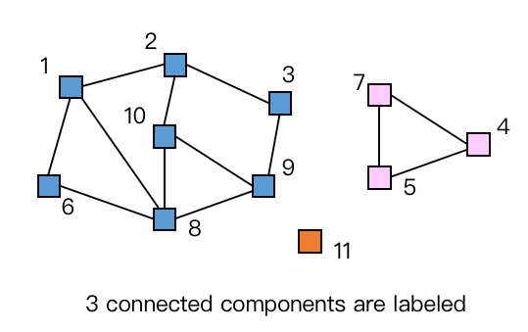
Depth-first Search for Labeling Connected components
Main {
i : integer
for i = 1 to n do M[i] := 0; //initial label is zero
label := 1;
for i = 1 to n do
if M[i] = 0 then DFS(G,M,i,label); //if i is not labeled
label := label + 1; //then call DFS
}
DFS(G[]: node ptr array, M[]: int array, i,label: int) {
v : node pointer;
M[i] := label;
v := G[i]; // first neighbor //
while v ≠ null do // recursive call (below)
if M[v.index] = 0 then DFS(G,M,v.index,label);
v := v.next; // next neighbor //
}

Slide 28
Performance DFS
n vertices and m edges
Storage complexity O(n + m)
Time complexity O(n + m)
Linear Time!

Slide 29
Breadth-First Search
//BFS
Initialize Q to be empty;
Enqueue(Q,1) and mark 1;
while Q is not empty do
i := Dequeue(Q);
for each j adjacent to i do
if j is not marked then
Enqueue(Q,j) and mark j;
end{BFS}

Slide 30
Can do Connectivity using BFS
Uses a queue to order search
2
1
7
3
5
6
4
Queue = 1

Slide 31
Beginning of example
2
1
7
3
5
6
4
Mark while on queue
to avoid putting in
queue more than once
Queue = 2,4,6

Slide 32
Breadth-First Search
void BFS(Graph* G, int start, Queue<int>*Q) {
int v, w;
Q->enqueue(start); // Initialize Q
G->setMark(start, VISITED);
while (Q->length() != 0) { // Process Q
v = Q->dequeue();
PreVisit(G, v); // Take some actions
for(w=G->first(v); w<G->n(); w=G->next(v,w))
if (G->getMark(w) == UNVISITED) {
G->setMark(w, VISITED);
Q->enqueue(w);
}
}
}

Slide 33
Depth-First vs Breadth-First
Depth-First
  Stack or recursion
  Many applications
Breadth-First
  Queue (recursion no help)
  Can be used to find shortest paths from the start vertex

Slide 34
Topological Sort
Section 9.2

Slide 35
Topological Sort
Given a series of tasks such as classes or jobs with prerequisite constraints, one task cannot be started until its prerequisites are completed.
Organize the tasks into a linear order so that they are completed one at a time without violating any prerequisites.
Programming C++
Data Mining
Data Structure

Slide 36
Topological Sort
Given a digraph G = (V, E), find a linear ordering of its vertices such that:
  for any edge (v, w) in E, v precedes w in the ordering
B
C
A
D
F
E

Slide 37
Topological Sort
Any linear ordering in which all the arrows go to the right is a valid solution
B
C
A
D
F
E
Topological Sort
A
B
F
C
D
E
Note that F can go anywhere in this list because it is not connected. Also the solution is not unique.

Slide 38
Topological Sort
bad example
B
C
A
D
F
E
NO!
A
B
F
C
E
C

Slide 39
Topological Sort
Only direct acyclic graphs (DAG) can be topological sorted
B
C
A
D
F
E
cyclic graph

Slide 40
Topological Sort Algorithm
Step 1: Identify vertices that have no incoming edges
  The “in-degree” of these vertices is zero
  Select one of such vertices
  If no such vertices, graph has only cycle(s) (cyclic graph), Topological sort not possible – Halt
B
C
A
D
F
E
B
C
A
D

Slide 41
Topological Sort Algorithm
Step 2: Delete this vertex of in-degree 0 and all its outgoing edges from the graph. Place it in the output
B
C
A
D
F
E
A

Slide 42
Topological Sort Algorithm
Repeat Step 1 and Step 2 until graph is empty
B
C
A
D
F
E
A
B
F
C
D
E

Slide 43
Topological Sort Algorithm Implementation
Assume adjacency list representation
B
C
A
D
F
E
① Translation array
0
1
2
3
4
5
1
3
0 | 1 | 2 | 3 | 4 | 5
2
A | B | C | D | E | F
3
4
4

Slide 44
Topological Sort Algorithm Implementation
② Calculate In-degrees
// in-degree array D[];
// vertex array A[]
for i = 0 to n-1 do D[i] := 0; endfor
for i = 0 to n-1 do
x := A[i];
while x ≠ null do
D[x.value] := D[x.value] + 1;
x := x.next;
endwhile
endfor

Slide 45
Topological Sort Algorithm Implementation
② Calculate In-degrees
0 | 1 | 2 | 3 | 4 | 5
0 | 1 | 1 | 2 | 2 | 0
In-Degree array; or add a field to vertex array
0
1
1
2
2
0
0
1
2
3
4
5
1
3
2
3
4
4

Slide 46
Topological Sort Algorithm Implementation
Maintaining Degree 0 Vertices
  Key idea: Initialize and maintain a queue (or stack) of vertices with In-Degree 0
③ enqueue the vertices with In-Degree 0
0
1
1
2
2
0
0
1
2
3
4
5
1
3
2
3
4
Queue
0
5
4
1
2
0
3
5
4

Slide 47
Topological Sort Algorithm Implementation
④ dequeue vertex from queue to output;
update In-Degree array;
enqueue any vertex whose In-Degree becomes zero.
0
1
1
2
0
0
1
1
2
2
0
0
1
2
3
4
5
1
3
Queue
0
5
1
1
3
0
dequeue
0
enqueue in-degree 0 vertex
2
Output
3
4
0
4
Delete this vertex of in-degree 0 and all its outgoing edges from the graph
1
update In-Degree array
2
0
3
4
5

Slide 48
Topological Sort Algorithm
Store each vertex’s In-Degree in an array D
Initialize queue with all “in-degree=0” vertices
While there are vertices remaining in the queue:
  (a) Dequeue and output a vertex
  (b) Reduce In-Degree of all vertices adjacent to it by 1
  (c) Enqueue any of these vertices whose In-Degree became zero
If all vertices are output then success, otherwise there is a cycle.

Slide 49
Topological Sort
//Queue-based topological sort
void topsort(Graph* G, Queue<int>* Q) {
int InDgree[G->n()]; //the size is the number of vertices
int v, w;
for (v=0; v<G->n(); v++) InDgree[v] = 0; //initialize
//compute indgree for every vertex
for (v=0; v<G->n(); v++) // Process every edge
for (w=G->first(v); w<G->n(); w=G->next(v,w))
InDgree [w]++; // Add to w's InDgree
for (v=0; v<G->n(); v++) // Initialize Queue Q
if (InDgree[v] == 0) // enqueue v with no prerequisites
Q->enqueue(v);
while (Q->length() != 0) { //process vertices in Q
v = Q->dequeue();
printout(v); // output v
for (w=G->first(v); w<G->n(); w=G->next(v,w)) {
InDgree[w]--; // One less prerequisite
if (InDgree[w] == 0) //vertex v is now free
Q->enqueue(w);
}
}
}
breadth-first

Slide 50
Topological Sort Analysis
Initialize In-Degree array: O(|V| + |E|)
Initialize Queue with In-Degree 0 vertices: O(|V|)
Dequeue and output vertex:
  |V| vertices, each takes only O(1) to dequeue and output: O(|V|)
Reduce In-Degree of all vertices adjacent to a vertex and Enqueue any In-Degree 0 vertices:
  O(|E|)
For input graph G=(V,E) run time = O(|V| + |E|)
  Linear time!

Slide 51
Another Topological Sort Algorithm
Topological Sort using a depth-first strategy
  When a vertex is visited, do nothing
  When the recursion pops back to that vertex, print the vertex
  A topological sort is printed in reversed order.
void topsort(Graph* G) {
int i;
for (i=0; i<G->n(); i++) // Initialize Mark
G->setMark(i, UNVISITED);
for (i=0; i<G->n(); i++) // Process vertices
if (G->getMark(i) == UNVISITED)
tophelp(G, i); // Call helper
}
void tophelp(Graph* G, int v) { // Process v
G->setMark(v, VISITED);
for (int w=G->first(v); w<G->n(); w=G->next(v,w))
if (G->getMark(w) == UNVISITED)
tophelp(G, w);
printout(v); // output v
}

Slide 52
DFS, BFS and Topological Sort
Depth-first search (DFS)
  For both directed and undirected graphs
  It is implemented using a stack or recursion
Breadth-first search (BFS)
  For both directed and undirected graphs
  It is implemented using a queue
Topological sort
  For directed acyclic graphs (DAG)
  It is implemented using DFS or a queue-based method

Slide 53
Homework 7-1
Textbook Exercises 9.1
上交到课程中心（第九章图论-第一次课后作业Exercises 9.1）

